Slide 1

Predicting Wildfire Severity
David Cavanaugh
Math 8670: Advanced Statistical Machine Learning
December 14, 2021

Slide 2
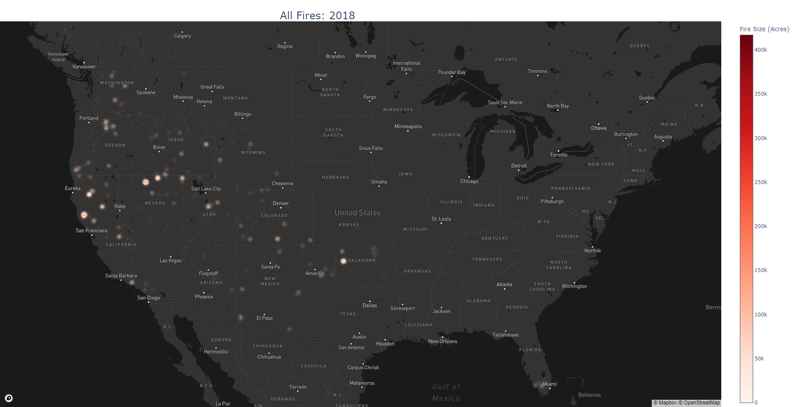
Data Overview
Data Source:
U.S. Department of Agriculture Research Data Archive
General Details
Starts in 1992, ends in 2018
Covers every state in the U.S.
Geographically allocated at the State and County level
Our dataset contains over 2 million individual fires
Each row indicates a single fire
Variables of Interest
Fire location: State, County
Fire Size (acres burned)
Fire start date

Slide 3
Additional Data
Weather Data
National Oceanographic and Atmospheric Administration (NOAA)
Precipitation, Min and Max temperature by month for select states from 1992 to 2018
Joined to fire data via state and month
County Spatial Data
U.S. Census Bureau
County size in acres for all counties in U.S.
Size serves as a standardization factor of burn area by county since larger counties => increased fire size
Joined to fire data by county state and county identifier, more technically, FIPS Code
Note:
For this project we only considered Western U.S. States which includes Washington, Oregon, California, Idaho, Nevada, Arizona, Montana, Utah, New Mexico, Colorado and Wyoming

Slide 4
Data Preparation
Filling Nulls
Almost all fires had a lat/long point associated to it, however, over 600K fires were missing proper county identifiers
Using a spatial data frame with all the polygons for the U.S. counties I was able to fill in most of those missing county identifiers via a spatial join matching fire lat/long coordinates which were within specific county polygons
Aggregation
Individual fires were aggregated to the county and month level. The fire size was summed up to get total burn area for a given county and month

Slide 5
Research Question
Can we use historical fire data, in conjunction with weather and county spatial data to model the severity (size) of wildfires by month for the selected counties?

Slide 6
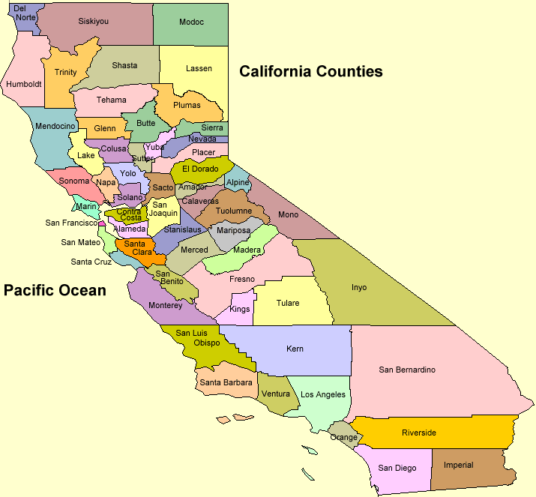
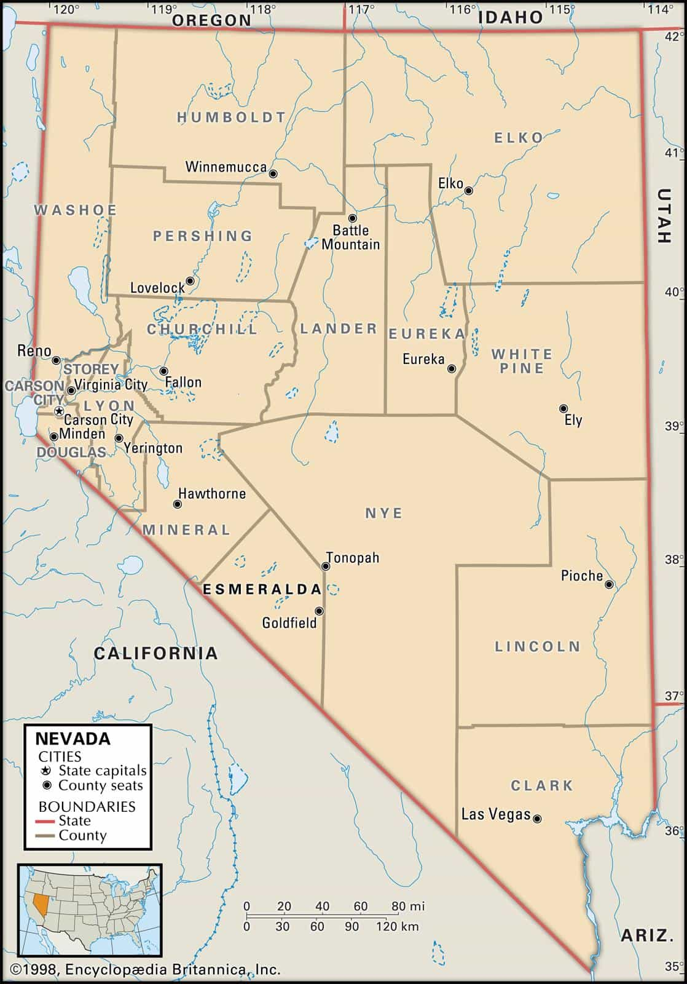
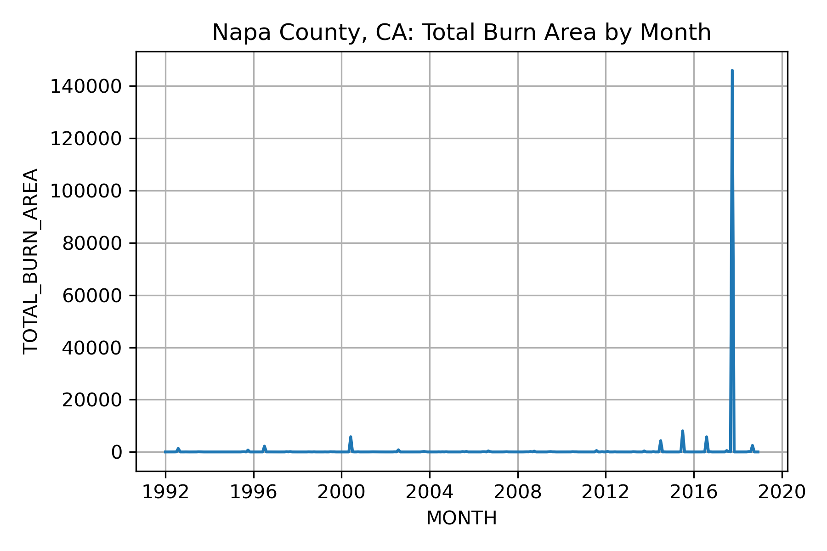
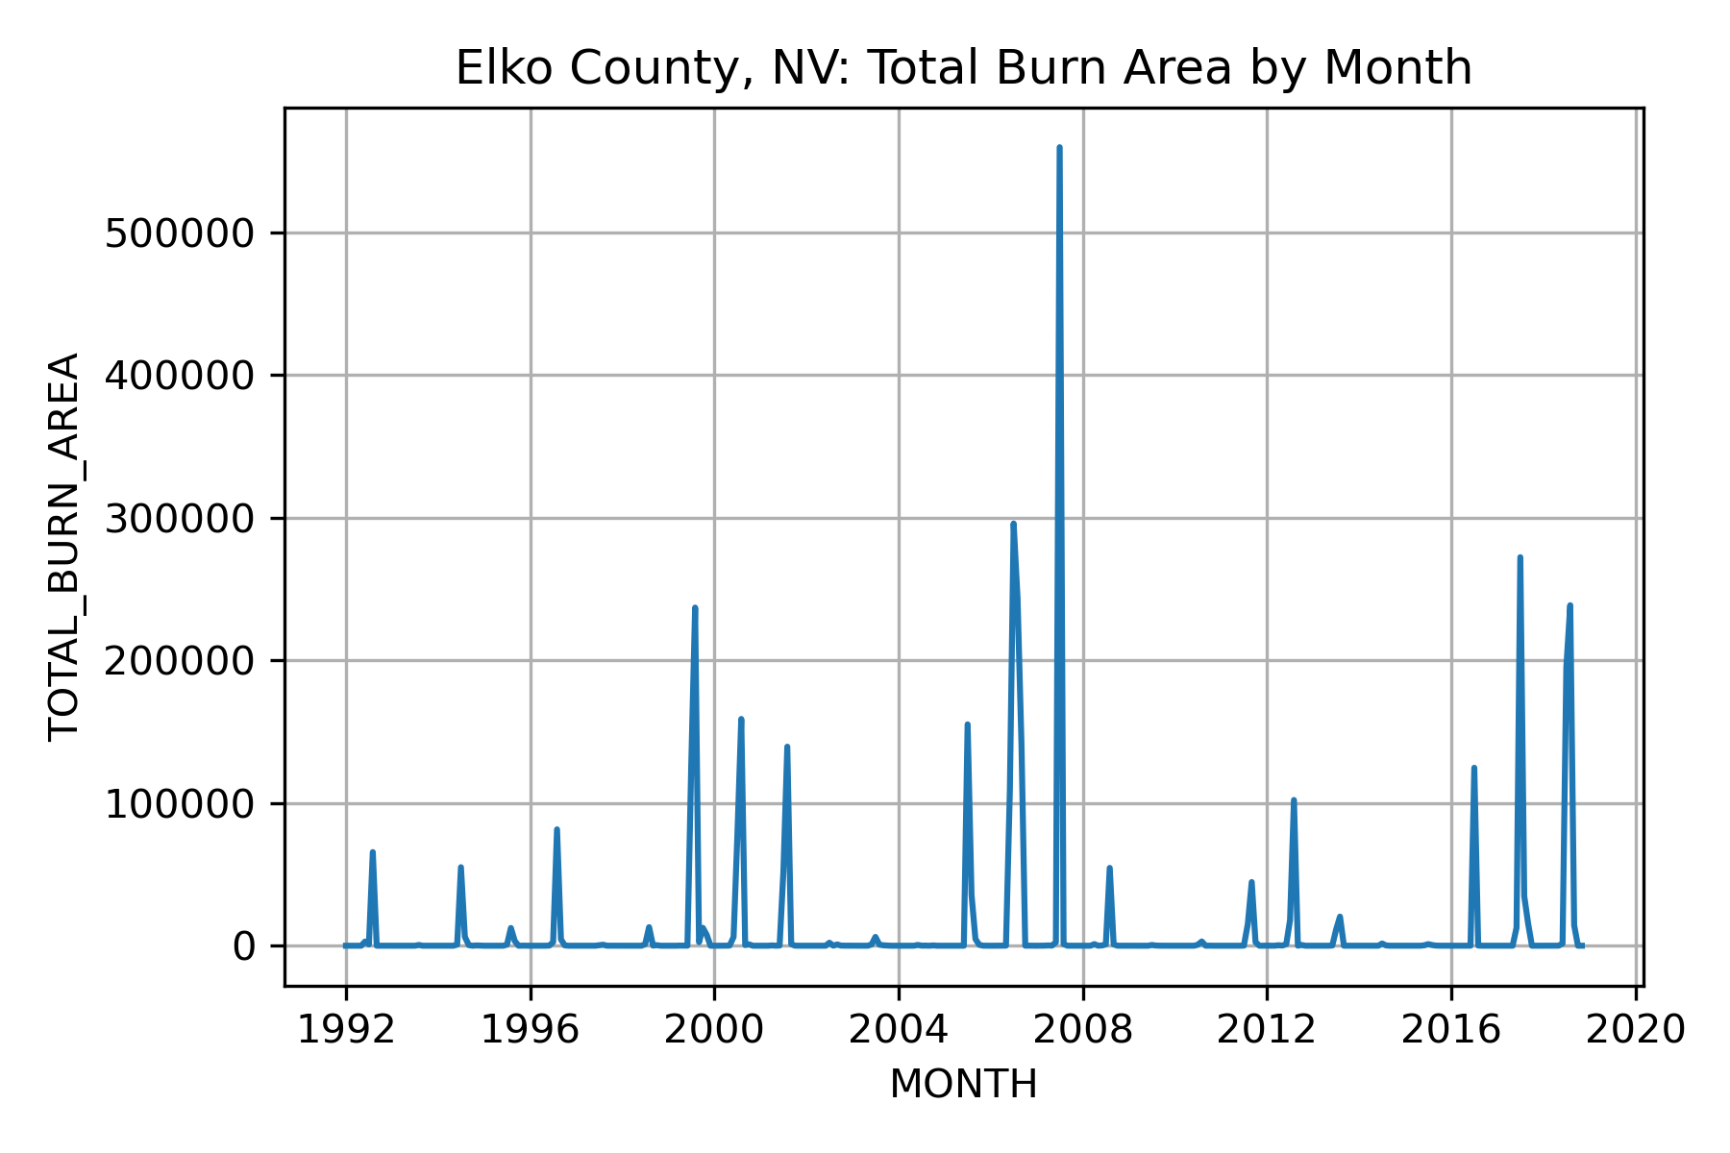
Data Visualization
We use specific counties as examples to make analysis clearer
Napa County, California
Area: 788 sq mi
Elko County, Nevada
Area: 17,203 sq mi
Time Series Plots
Spikes in Napa County will be more difficult to predict than the more cyclical Elko County

Slide 7
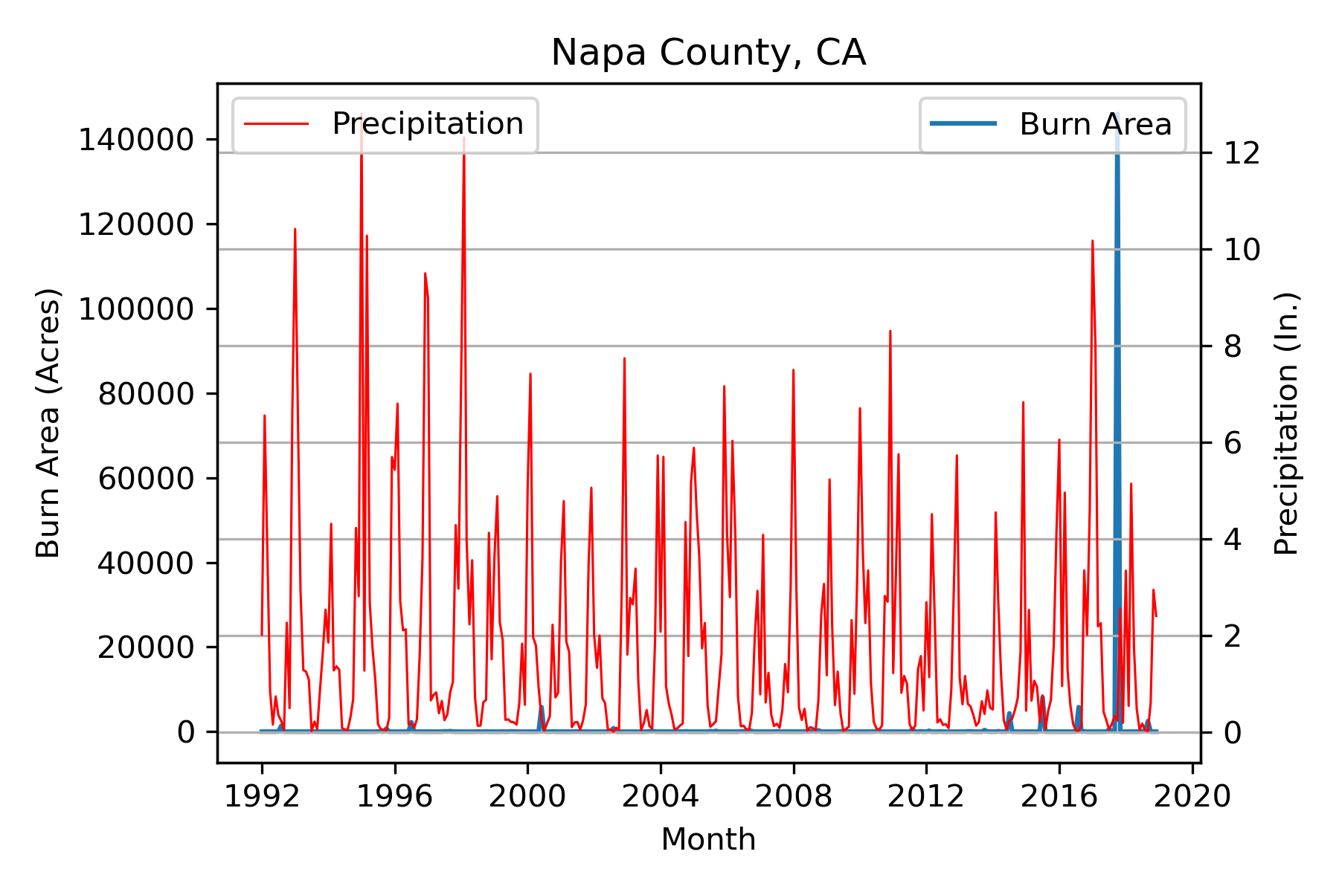
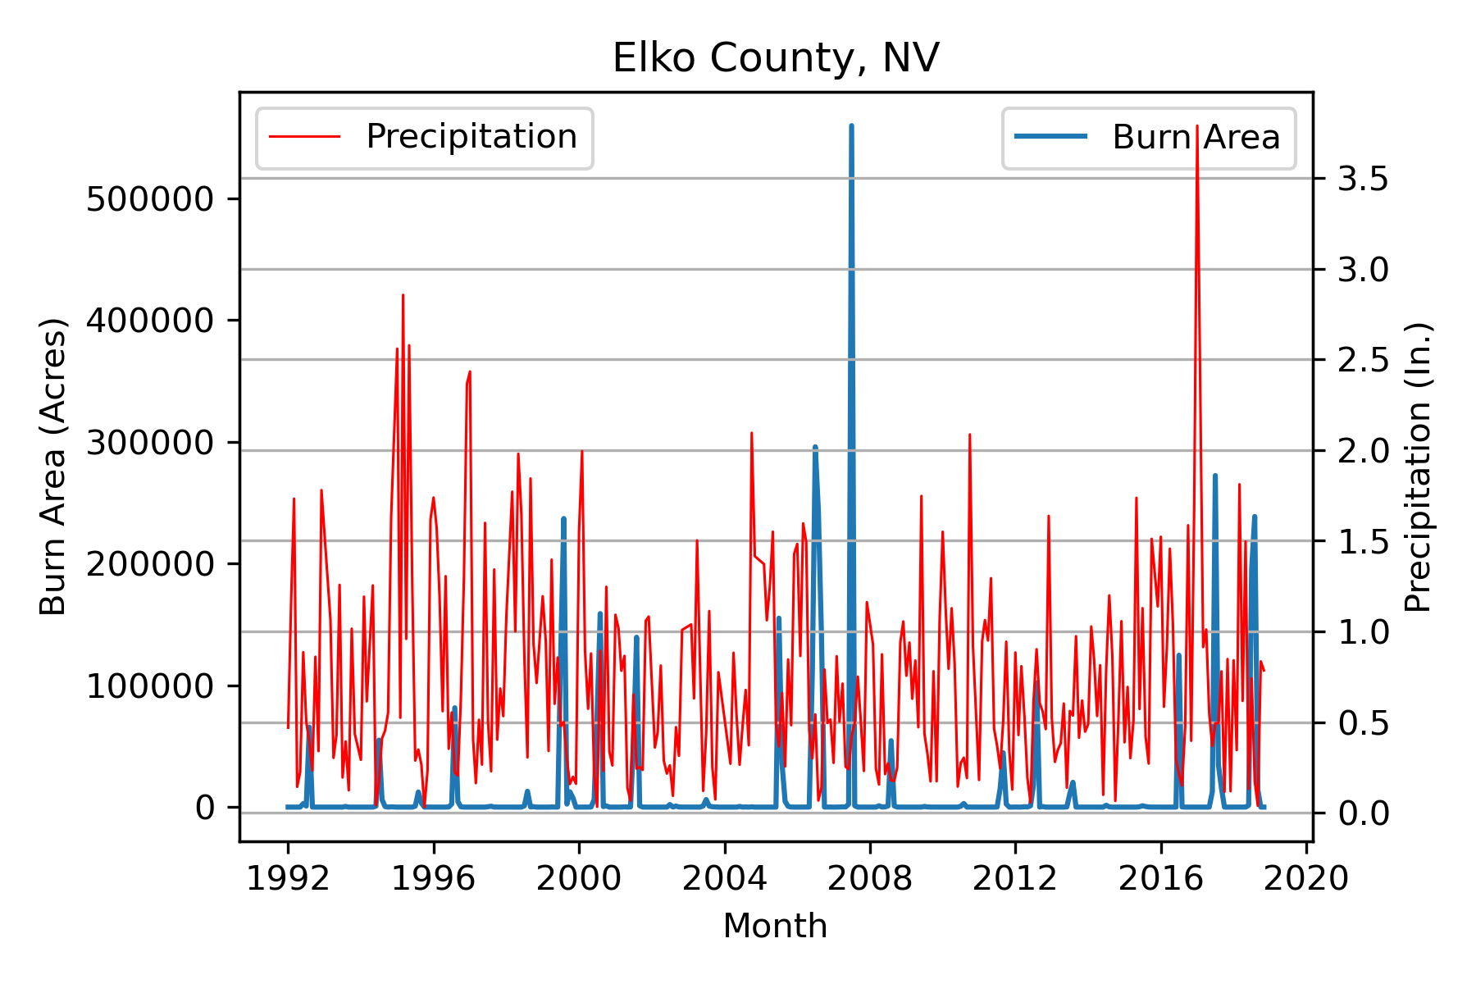
Data Visualization Cont’d
Visualize Precipitation with Burn Area
Precipitation is at the state level, so we are seeing precipitation data for California and Nevada as a whole
Precipitation in CA appears to be more consistent than in NV

Slide 8
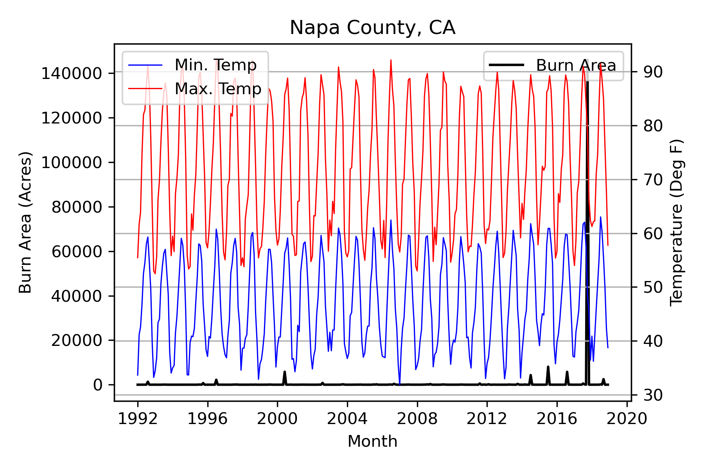
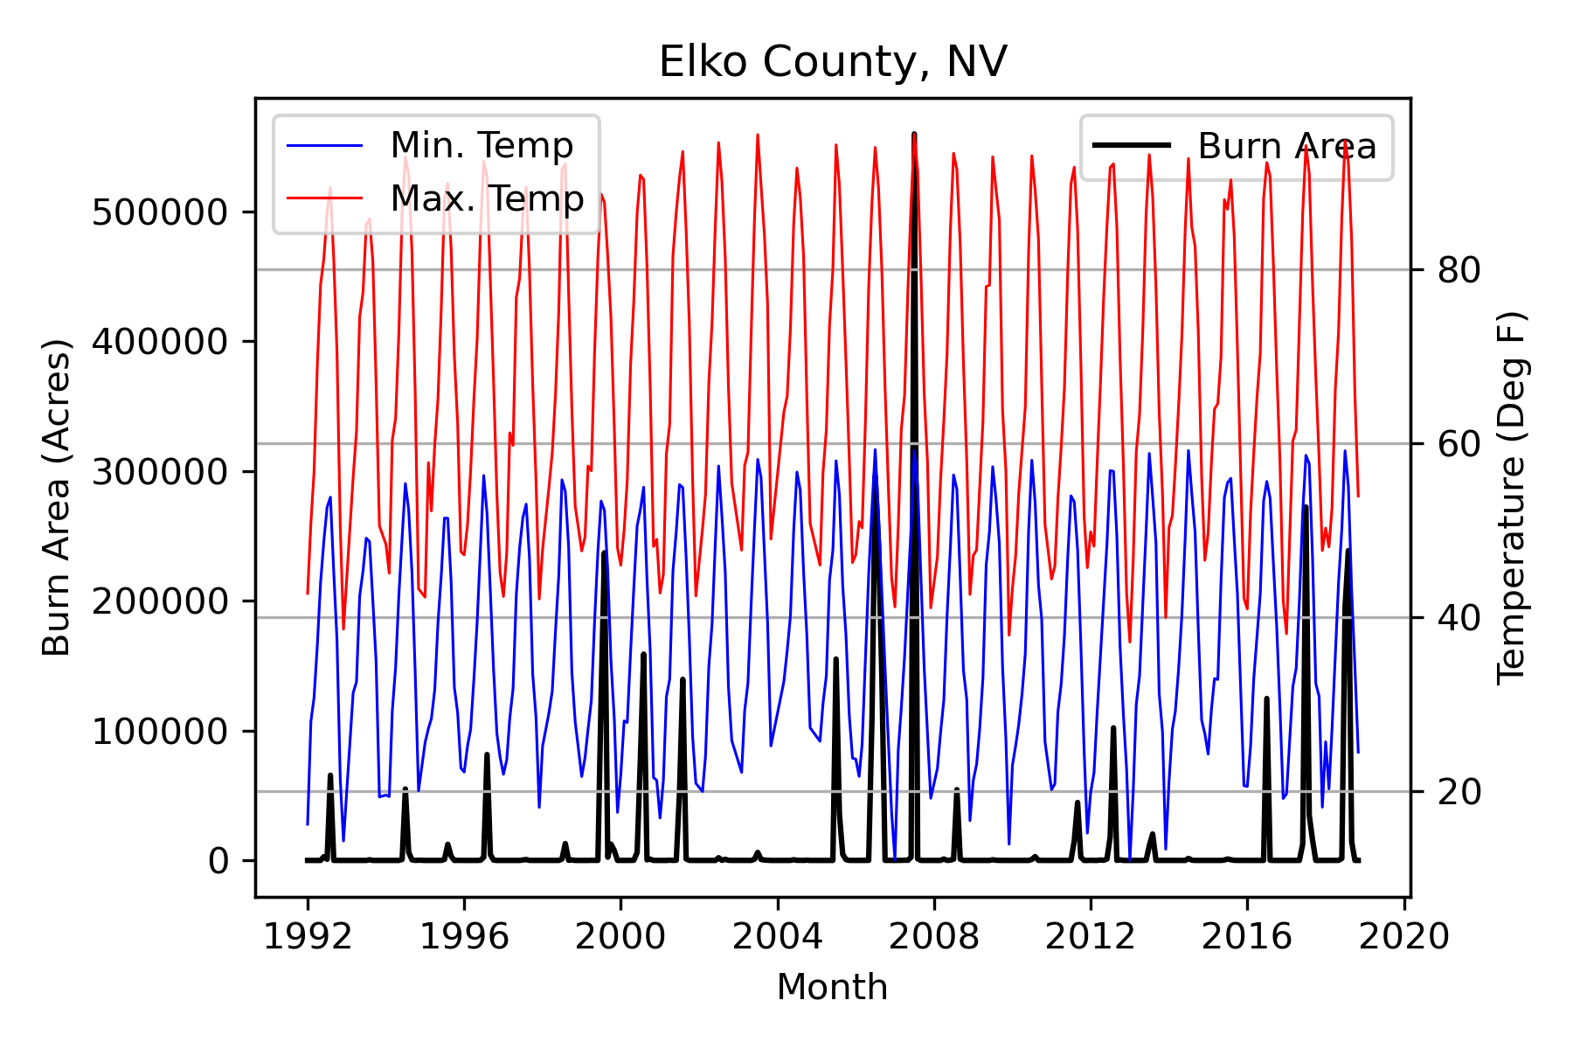
Data Visualization Cont’d
Visualize Temperature with Burn Area
Average high temperatures are similar, the average lows for Nevada are lower than CA
Fires in Nevada typically correspond to the months of highest temperature (summers)
There doesn’t appear to be much correlation between temperature and burn area in CA

Slide 9
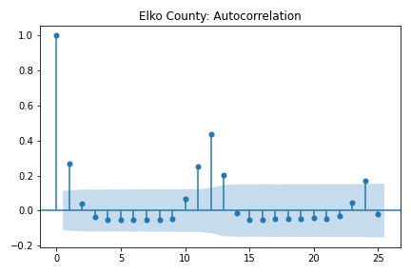
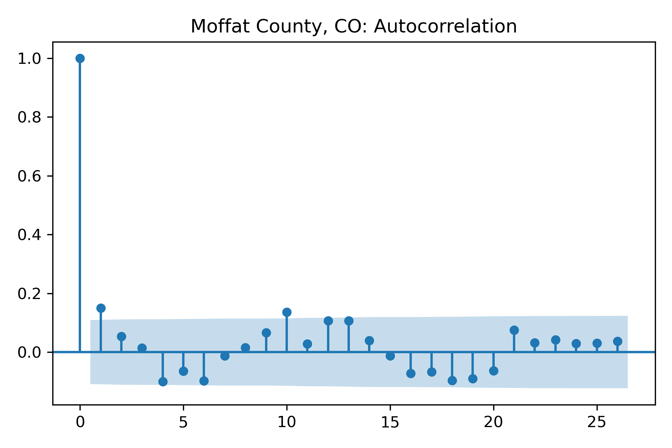
Model Framework
Utilize a time lagged design matrix
This involves lags for burn area, precipitation, and temperature for both immediate lags (i.e., 1,2,3, … periods ago) as well as for annual lags (i.e., 11, 12, 13, 23, 24, 25 periods ago)
Motivated by observed auto-correlation for some counties

Slide 10
Model Framework Cont’d
Include county area
Account for the fact that larger counties typically have more land to burn
Fun fact: although we did not include Alaska, there are some counties in Alaska with county areas larger than most entire states
Include categorical variables for individual county and state
This may account for varying wildfire containment or prevention policies by county or state as those are likely left up to local governments to determine
This consists of 411 individual counties and 11 states
The large number of categories may be an issue unless we handle them carefully

Slide 11
Model Fitting
Data is separated into training and testing sets chronologically for each county.
That is; 1992-2016 is used for training and 2017 - 2018 is used for testing
Accuracy metrics
Root mean squared error
Mean absolute percent error
Median absolute error
Due to some of the outliers and extreme values in the data

Slide 12
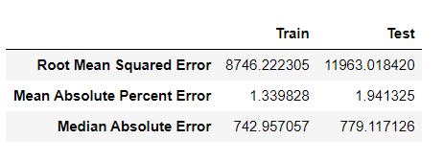
Model Fitting Cont’d
Start simple with linear regression and only a few variables.
Y = Total Burn Area
X includes county area, precipitation, min & max temperate, 1 & 12 period lags for total burn area
Parameters
No parameters are adjusted from Sci-Kit Learn defaults for LinearRegression
Accuracy
MAPE can be deceiving on its own, but it is used here primarily as a point of comparison with other models

Slide 13
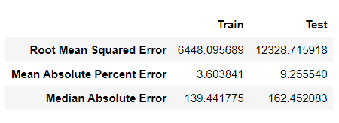
Model Fitting Cont’d
Switch to CatBoost
We want to be able to better handle the categorical variables for State and County
Parameters
Set has_time = True, this turns off some of the random permutations which occur in the building of the forests so that the time-dependent structure of the data is preserved, all other parameters are left as defaults
Include only the additional variables; we leave out any lag values of total burn area. Once we have selected the specific additional variables, we want we will add the lags of total burn area
Accuracy
Significant improvement on median absolute error compared to simple linear regression
Training RMSE improved but test did not,
MAPE was significantly worse.

Slide 14
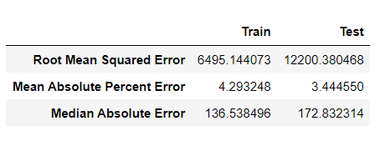
Model Fitting Cont’d
Reduce dimensionality
Eliminate variables based on feature importance, removing variables which have an importance of less than 1
Parameters
Keep has_time = True, and prune the tree by setting the max_depth = 5, also increase the size of the leaves to a minimum of 10 samples.
Accuracy
Test RMSE improved slightly
MAPE improved significantly

Slide 15
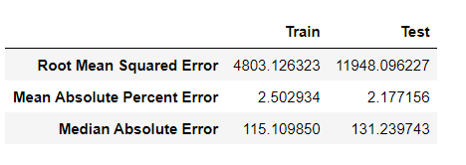
Model Fitting Cont’d
Add Auto-Regressive Terms
We first fit a model with all the lags of total burn area included and then by analyzing feature importance we remove all the variables, which also include some additional variables, which have an importance less than 1
Parameters
Keep has_time = True, and prune the tree by setting the max_depth = 5, also increase the size of the leaves to a minimum of 10 samples.
Accuracy
This model has the best RMSE for both train and test out of any model thus far
MAE is also best of any model so far

Slide 16
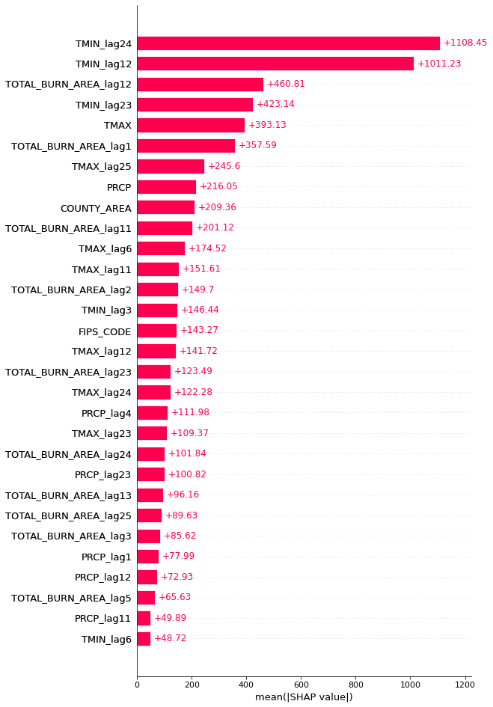
Model Interpretation
Feature Importance
Using Shap values
Weather
Captures the cyclical nature of wildfires and impact of weather on their size
Previous month/year burn area
Indicate the model is capturing the autocorrelation we noticed previously

Slide 17
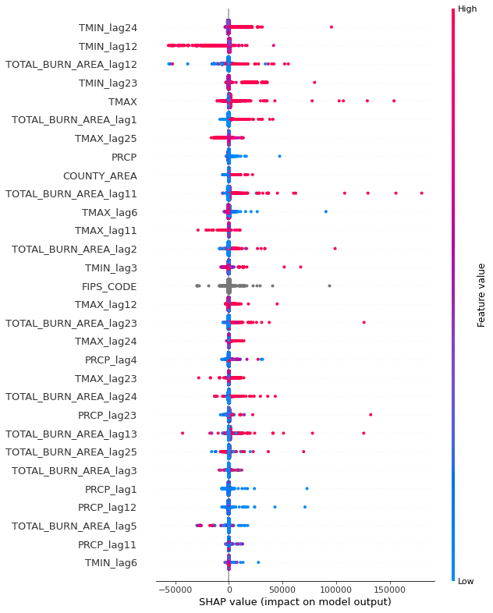
Model Interpretation Cont’d
Feature Impact
Using Shap value per prediction
Generally positive impact from previous month/year burn area
Impacts due to weather are difficult to explain since ‘extreme’ weather is relative to each state/county

Slide 18
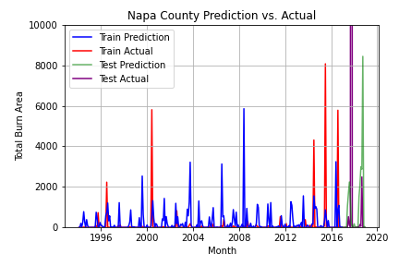
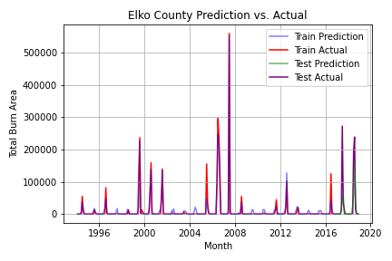
Predictions
Use the model to predict on the train and test sets and plot the results
As expected, Napa County model has major deficiencies
Elko County model does a decent job in training and testing spaces, the seasonal patterns are easier for the model to detect

Slide 19
Conclusions
Using this model, we can generate forecasts for individual counties and their monthly wildfire severity – we would have to forecast precipitation, and temperature so that we would have all our inputs available in the forecast space
A time lagged nueral network may be able to outperform the decision tree-based model but the simplicity of design and interpretability of the tree-based model is highly desirable
A model framework which is hierarchical may be able to better model the effects due to the individual counties and states, as the spatial-temporal structure of the data is ideally suited for a hierarchical framework
The extreme outliers are going to be difficult for any model to predict but some Bayesian techniques may be able to assign a probability to such events happening, as, even though they do happen, they are quite unlikely

